Slide 1
Exploring the data

Slide 2
DeltaFrequency Band

Slide 3
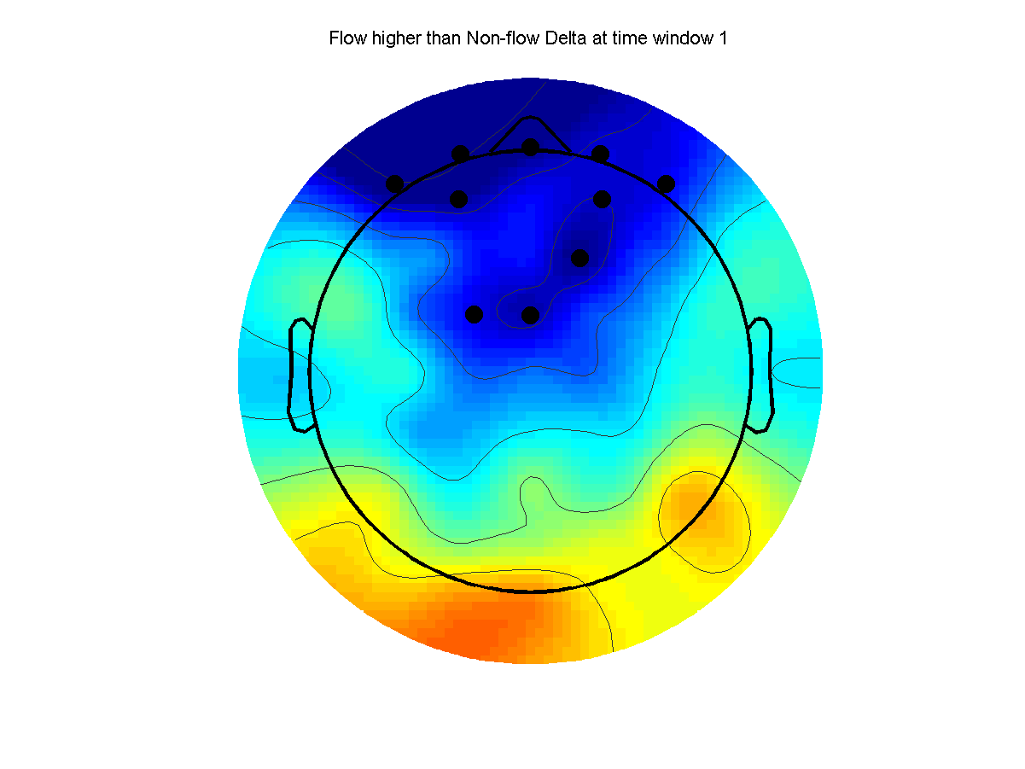
Flow higher than Non-flow Delta at time window 1

Slide 4
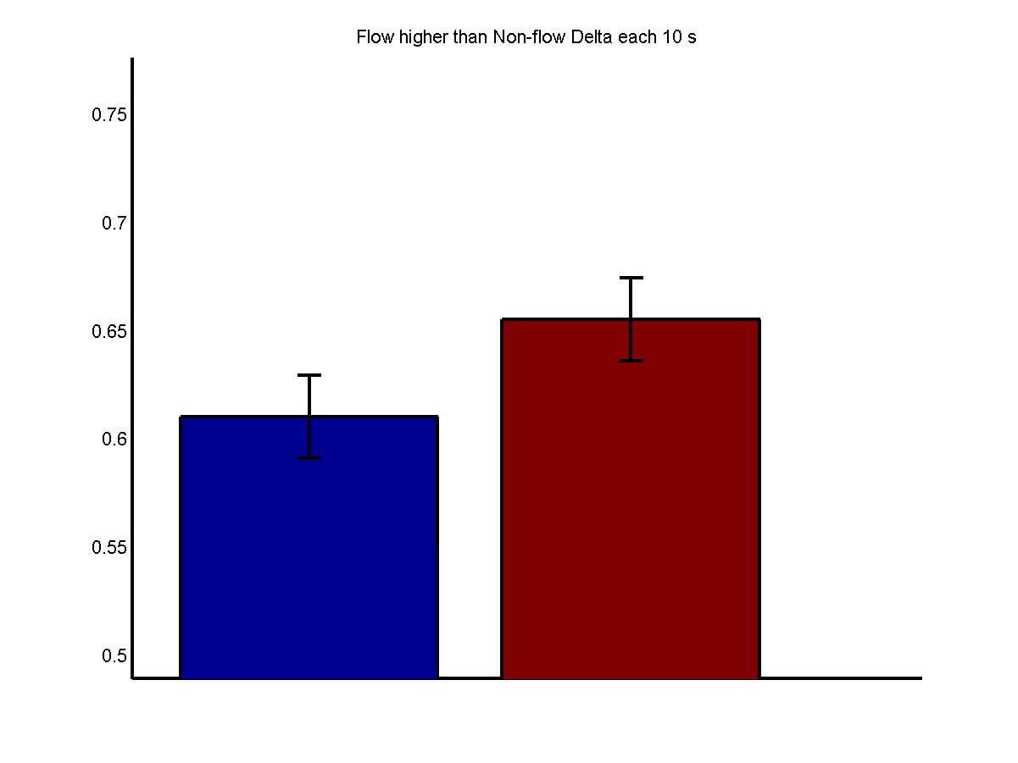
Flow higher than Non-flow Delta each 10 s

Slide 5
ThetaFrequency Band

Slide 6
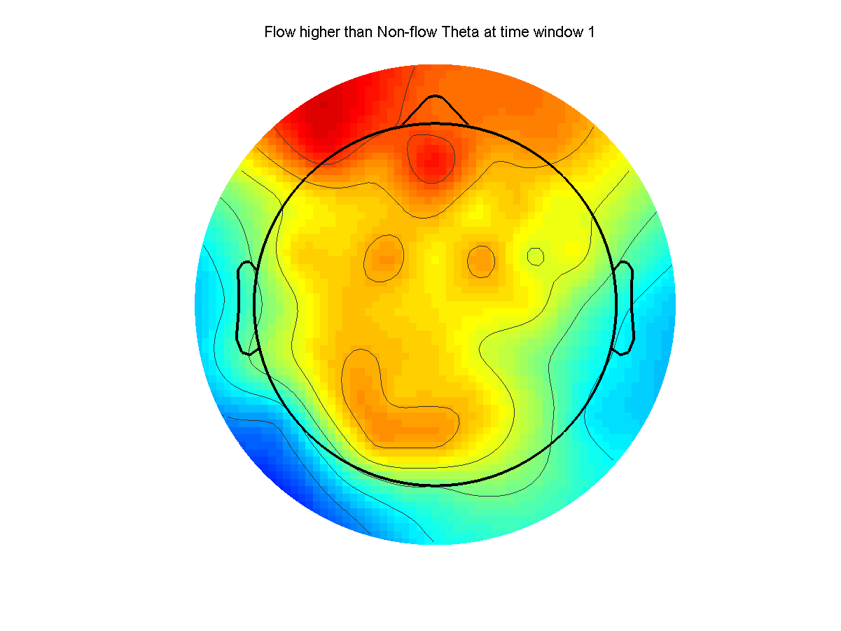
Flow higher than Non-flow Theta at time window 1

Slide 7
Alpha 1Frequency Band

Slide 8
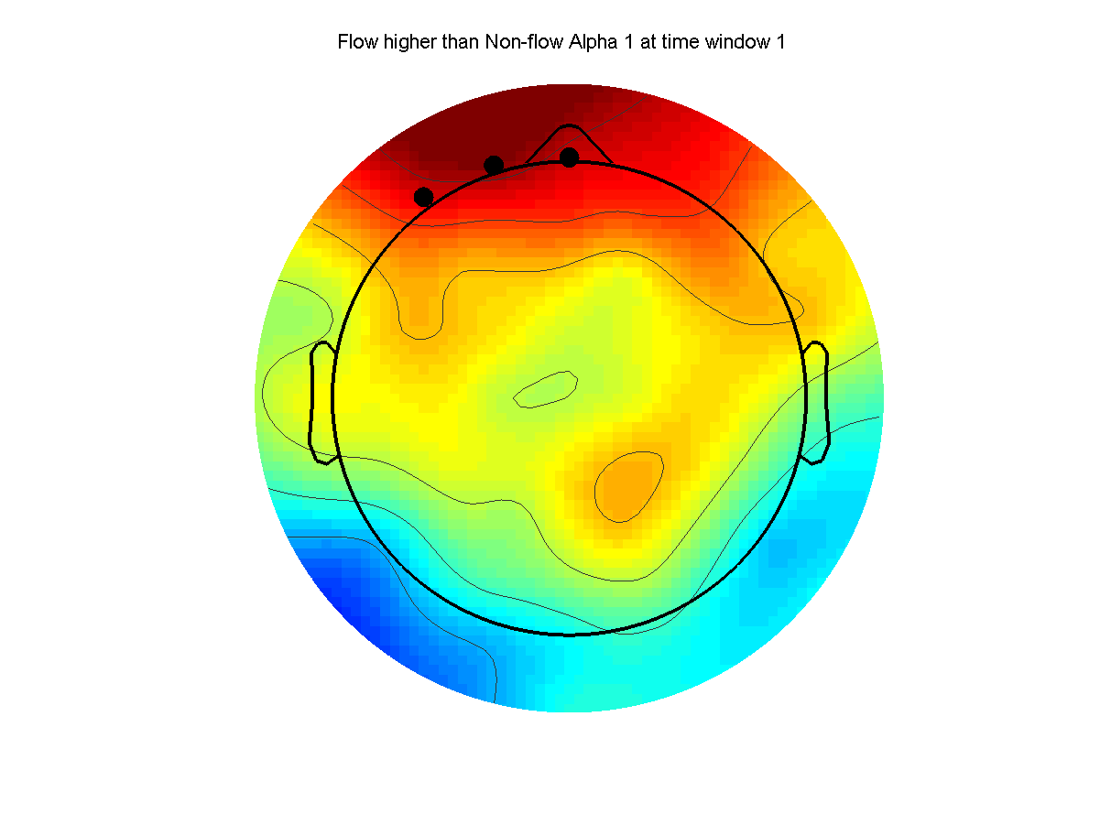
Flow higher than Non-flow Alpha 1 at time window 1

Slide 9
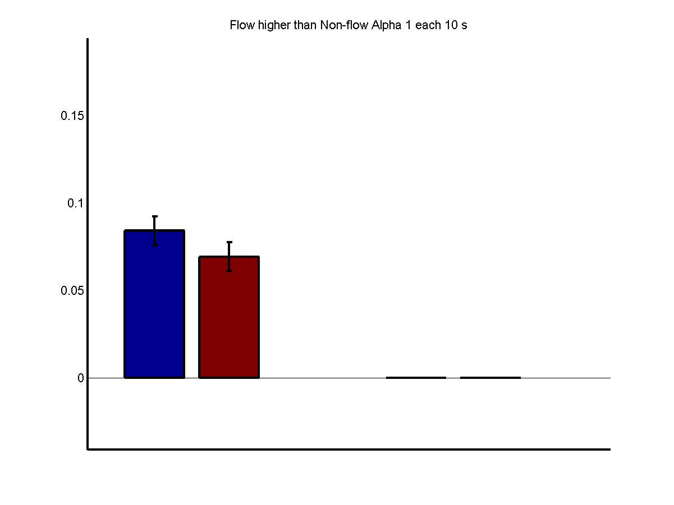
Flow higher than Non-flow Alpha 1 each 10 s

Slide 10
Alpha 2Frequency Band

Slide 11
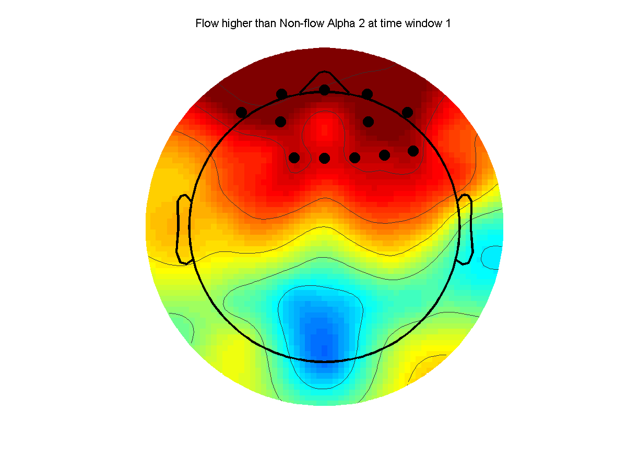
Flow higher than Non-flow Alpha 2 at time window 1

Slide 12
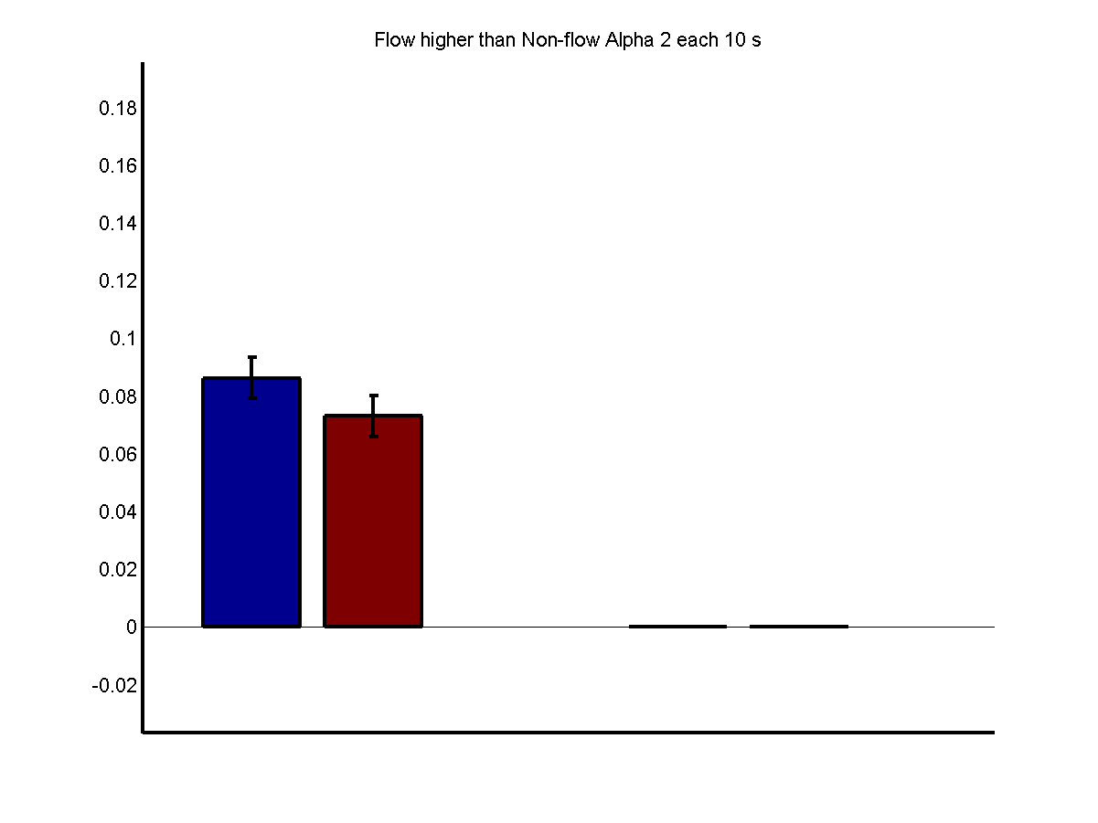
Flow higher than Non-flow Alpha 2 each 10 s

Slide 13
BetaFrequency Band

Slide 14
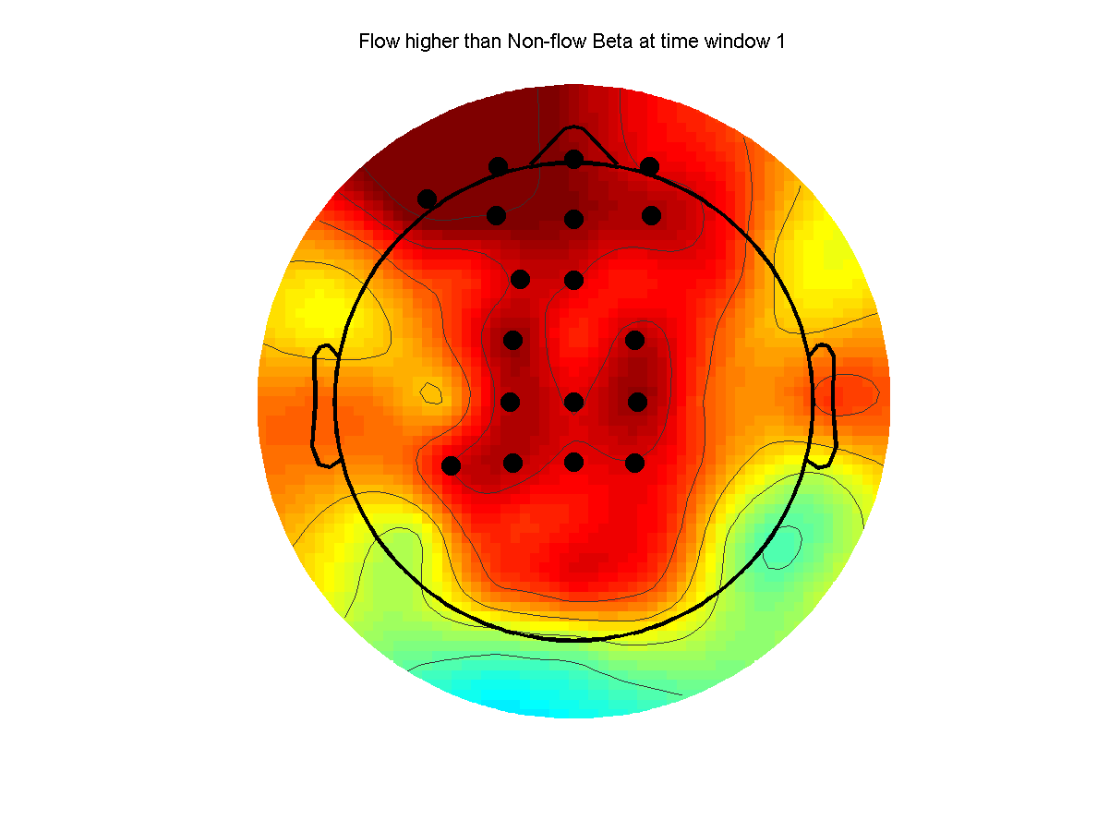
Flow higher than Non-flow Beta at time window 1

Slide 15
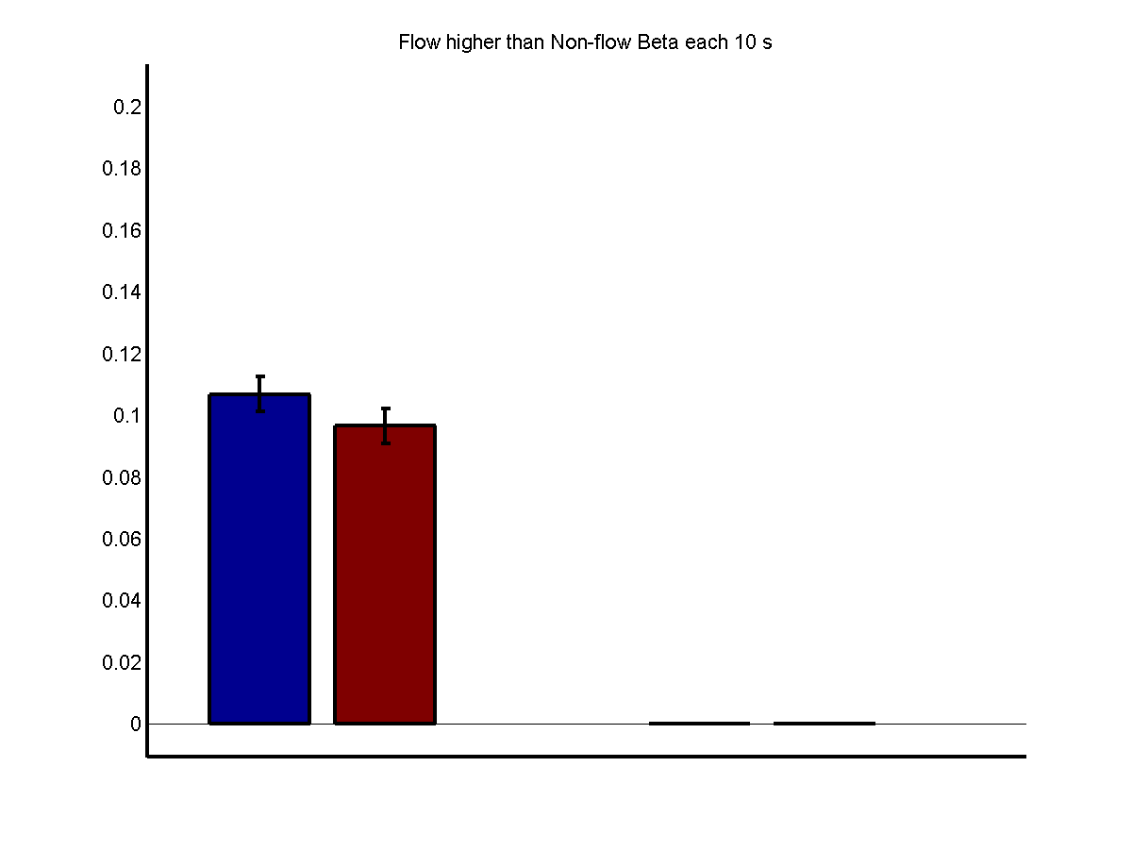
Flow higher than Non-flow Beta each 10 s

Slide 16
Gamma 1Frequency Band

Slide 17
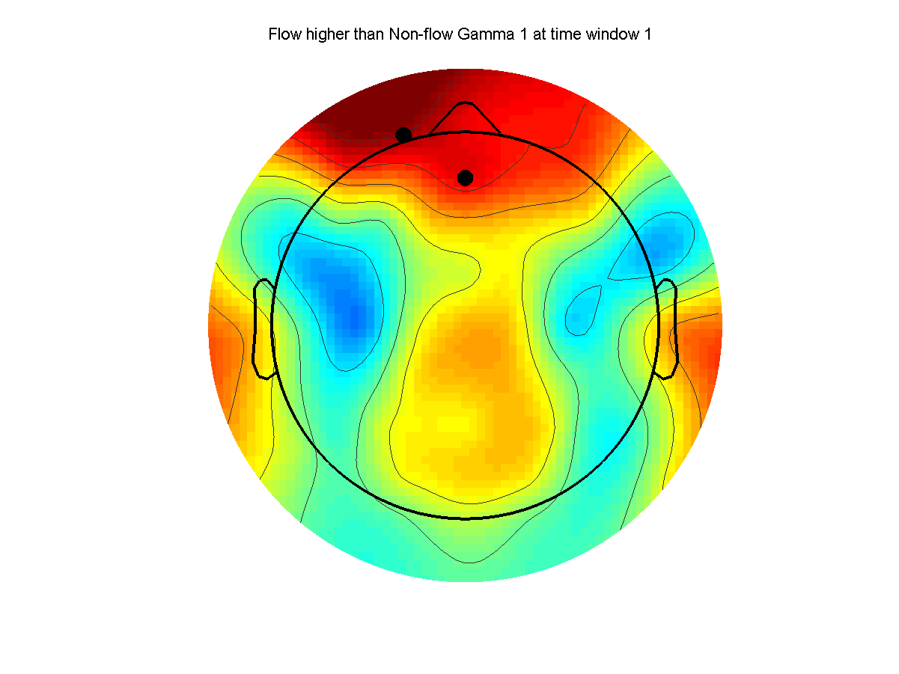
Flow higher than Non-flow Gamma 1 at time window 1

Slide 18
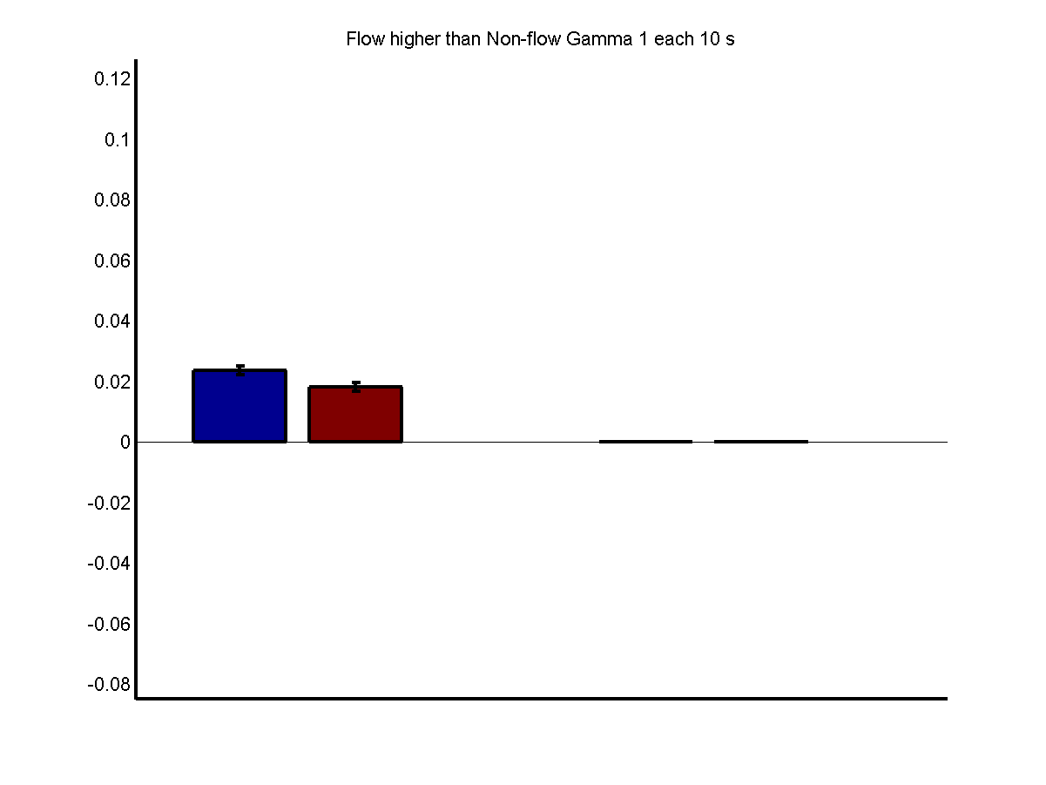
Flow higher than Non-flow Gamma 1 each 10 s

Slide 19
Gamma 2Frequency Band

Slide 20
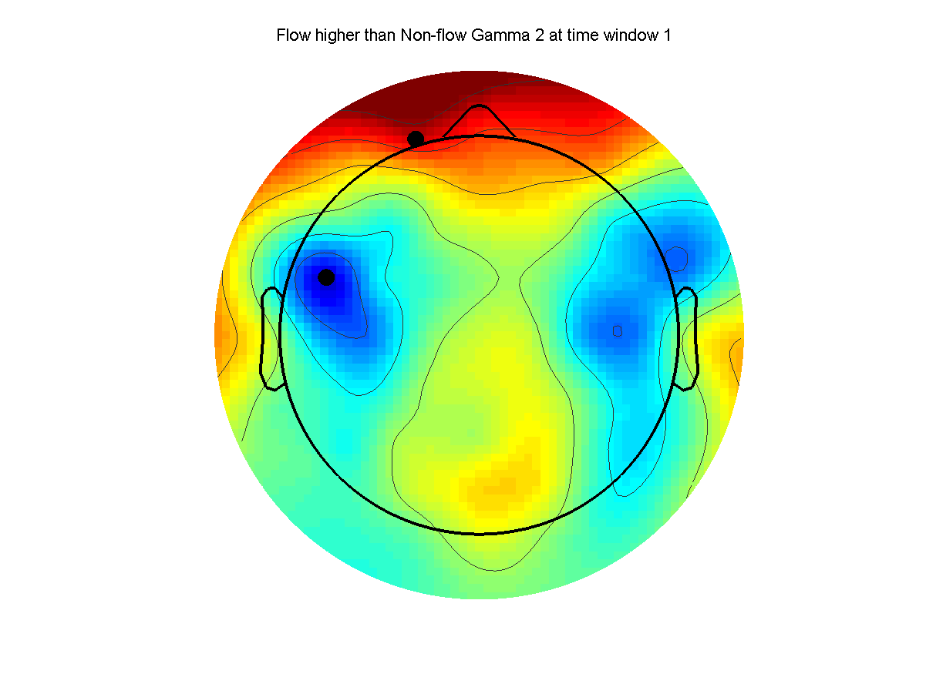
Flow higher than Non-flow Gamma 2 at time window 1

Slide 21
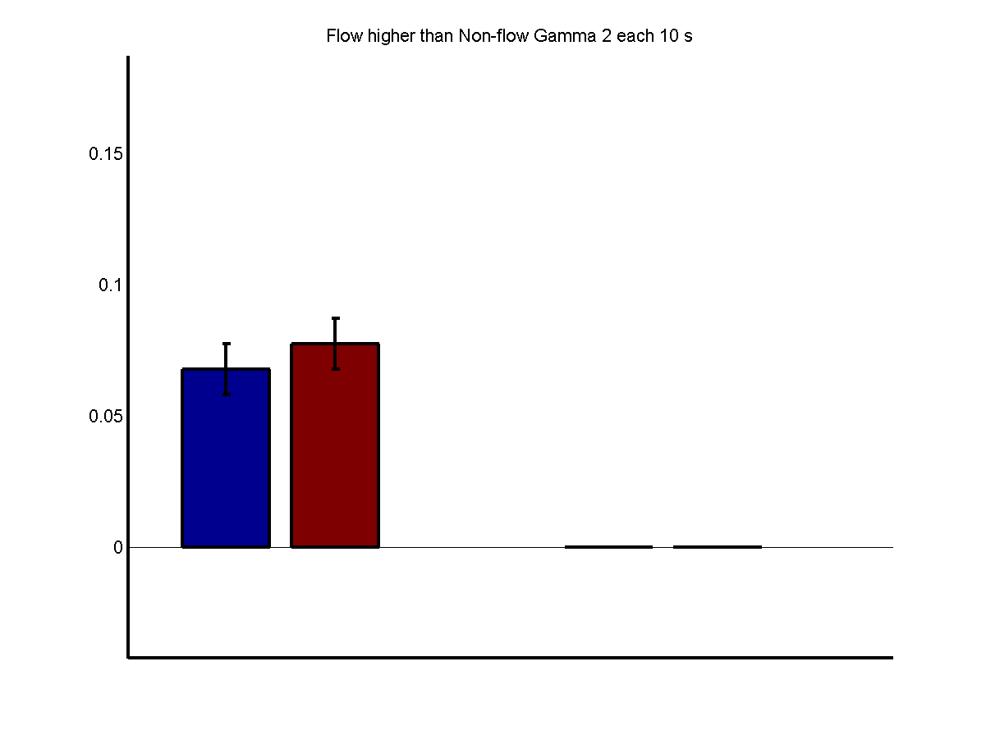
Flow higher than Non-flow Gamma 2 each 10 s

